Slide 1
Physical Chemistry
Ying Hu
(Fifth edition)
Bilingual Program
版权所有：华东理工大学物理化学教研室

Slide 2
Part IV Statistics
Chapter 12 Statistical Mechanics for Independent Particle Systems
Bilingual Program
版权所有：华东理工大学物理化学教研室

Slide 3
II. Statistical Distributions of Independent-Particle Systems
Bilingual Program
版权所有：华东理工大学物理化学教研室

Slide 4
Framework of the Chapter
II. Statistical Distributions of Independent- Particle Systems
12.5 Maxwell-Boltzmann Distribution
12.6 Molecular Partition Function

Slide 5
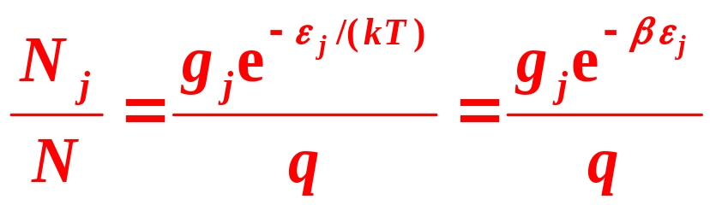
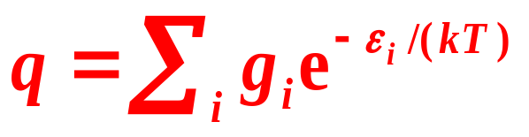
12.5 Maxwell-Boltzmann Distribution
Molecular partition function
Represents the summation of various microscopic states relevant to the macroscopic state of the system

Slide 6
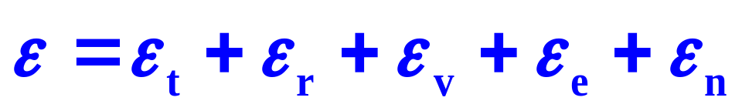
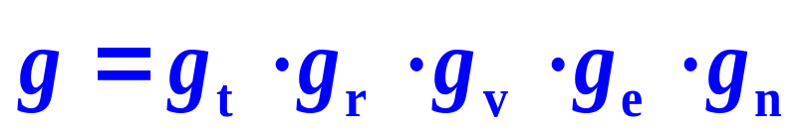
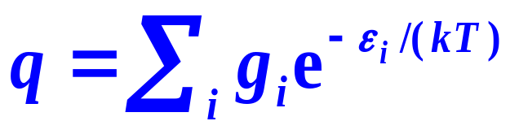
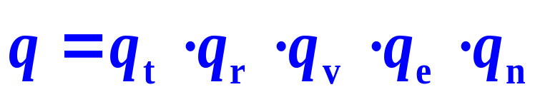
  12.6 Molecular Partition Function
2. Factorial Characteristics of the Molecular Partition Functions
The molecular partition function of a molecule can then be expressed by multiplying together the molecular partition functions of various forms of motions.

Slide 7
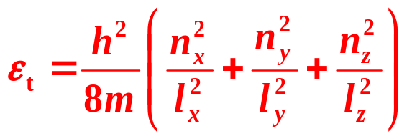
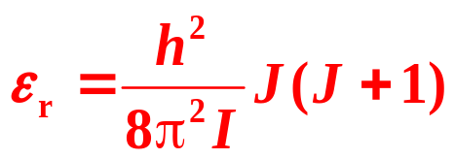
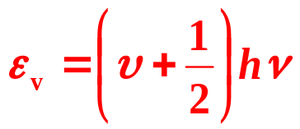
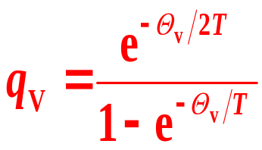
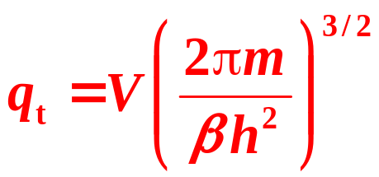
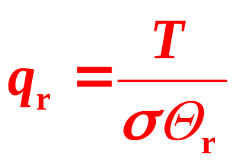
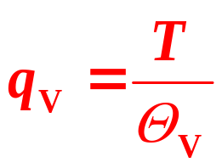
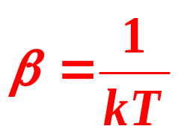


12.6 Molecular Partition Function
q_{t} > q_{r} > q_{v}
 | Translation | Rotation | Vibration
Energy level
Partition function
Charact eristics
Rotational temperature
Vibrational temperature
Symmetry number
σ

Slide 8
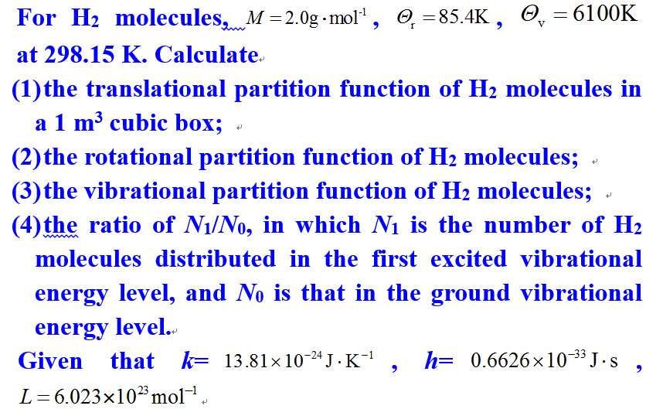
  12.6 Molecular Partition Function

Slide 9
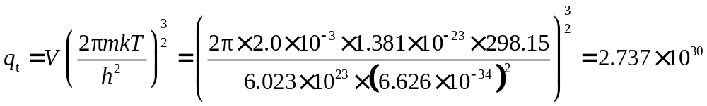
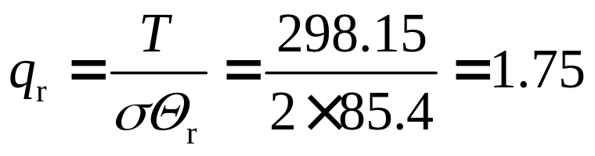
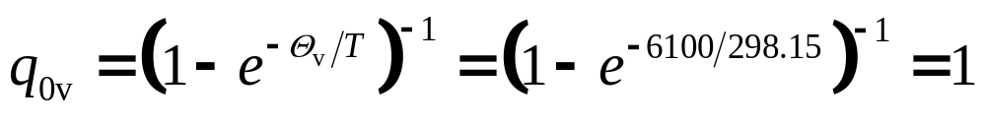
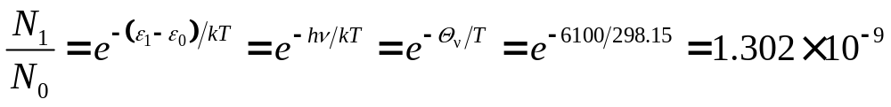
  12.6 Molecular Partition Function

Slide 10
III. Thermodynamic Properties of Independent-Particle Systems
Bilingual Program
版权所有：华东理工大学物理化学教研室

Slide 11
Framework of the Chapter
III. Thermodynamic Properties of Independent -Particle Systems
12.7 Thermodynamic Functions of Independent-Particle Systems
12.8 Standard Molar Heat Capacity of Gases
12.9 Heat Capacity of Crystals
12.10 Standard Molar Entropy of Gases
12.11 Standard Equilibrium Constant of Gaseous Reactions

Slide 12
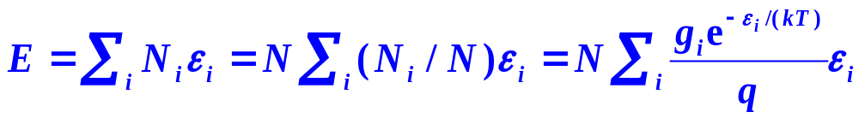
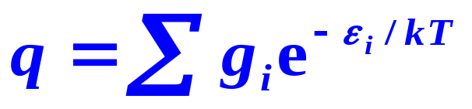
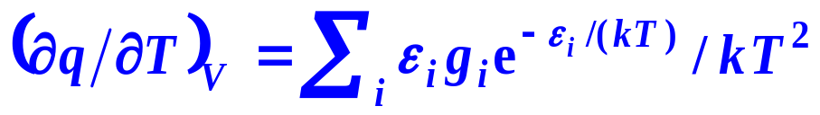
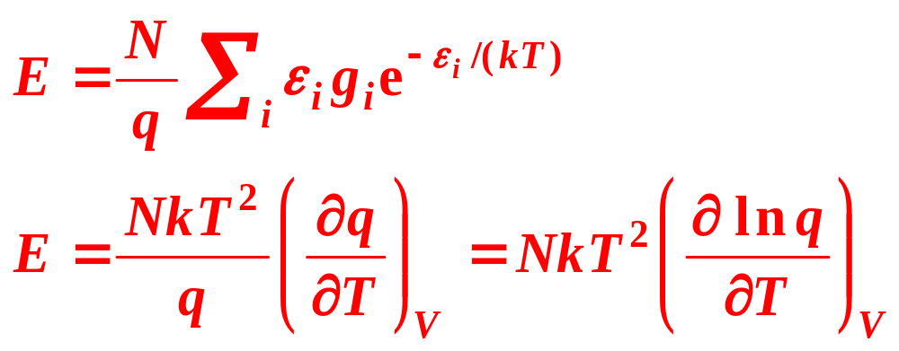
1. Energy of the Independent-Particle Systems
Statistical Average
Relation between Energy and the Molecular Partition Function

Slide 13
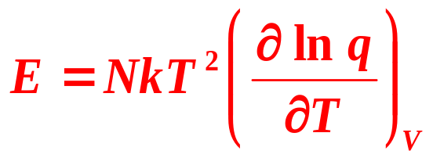
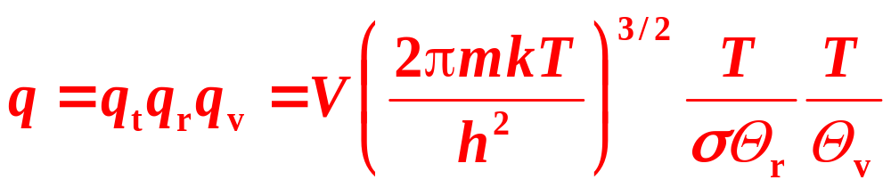
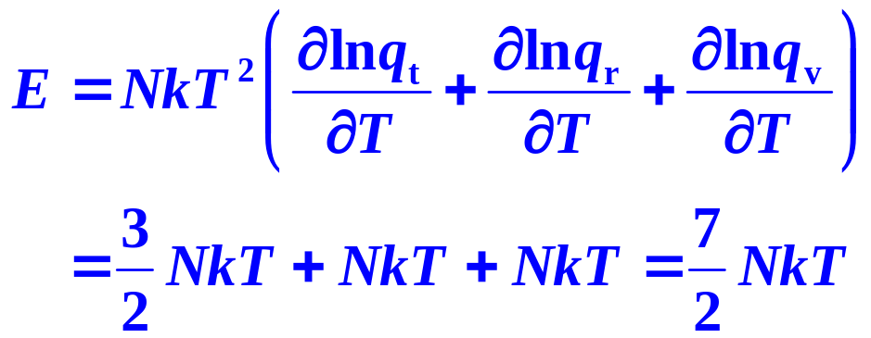
Energy Equipartition Theorem
If the temperature is high enough

Slide 14
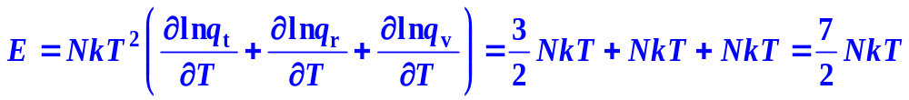
Energy Equipartition Theorem
The energy of the thermal movements is allocated in terms of the degrees of freedom of the motions of the molecule. Each degree has an energy of NkT/2 in principle.
For a diatomic molecule, there are 3 translational and 2 rotational degrees of freedom, with energies of 3NkT/2 and NkT.
Vibrational energy is composed of two parts, the kinetic energy and the potential energy. So one degree vibrational motion is with energies of NkT.

Slide 15
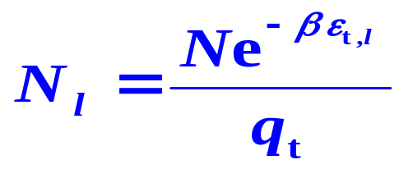
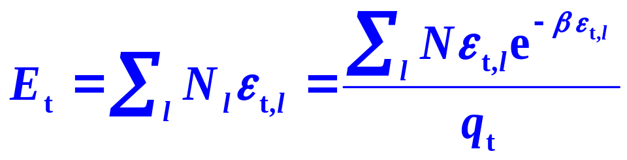
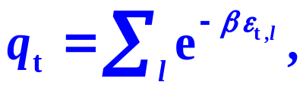
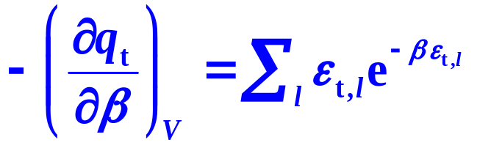
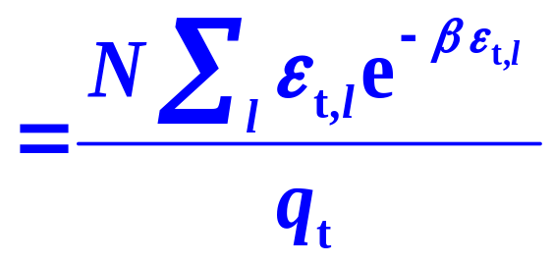
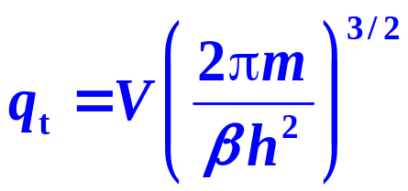
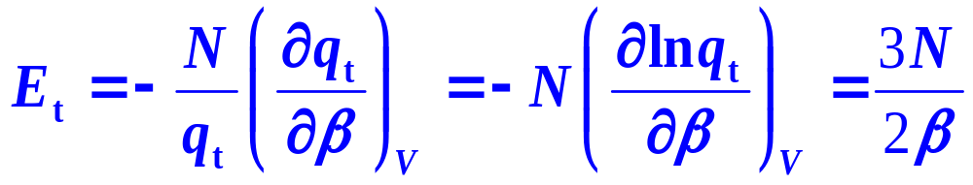
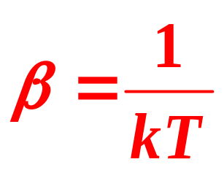
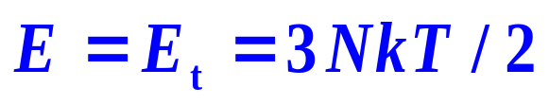
Determine β
Kinetic theory

Slide 16
Degree of Freedom of Motion
3n degrees of freedom of motion
 | Diatomic molecules | Multi-atom molecules | Linear Multi-atom molecules
Translational (x, y, z) of the center of mass | 3 | 3 | 3
Rotational (three axes) | 2 | 3 | 2
Vibrational | 1 | 3n-6 | 3n-5

Slide 17

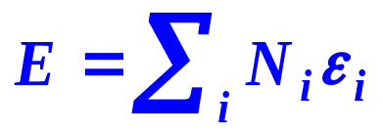
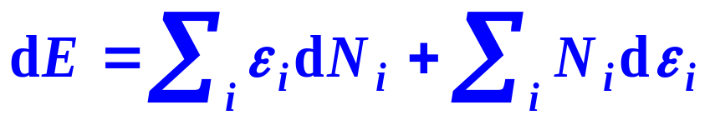
2. Entropy of the Independent-Particle Systems
The entropy is a non-mechanical quantity without the corresponding microscopic counterpart. It can be obtained by comparison with the thermodynamic results based on the statistical calculations for the mechanical quantities.
(1) Relation between Entropy and the Distribution in terms of Energy Levels
For a homogeneous closed system
macroscopic form of the thermodynamic fundamental equation
(U = E)
microscopic form of the thermodynamic fundamental equation

Slide 18
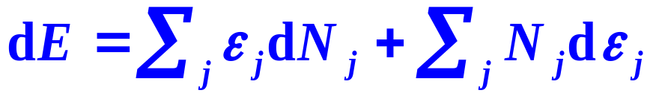

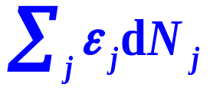
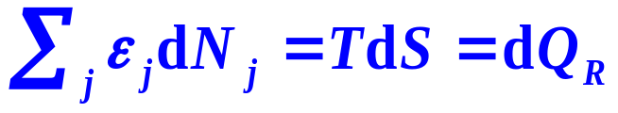
2
2
Fixed ε_{i}, the change of N_{i}
1
1
0
0
When the energy level ε_{i} is fixed, then V is kept unchanged.
is just the term TdS, represents the heat exchange between the system and the surroundings.
-

Slide 19

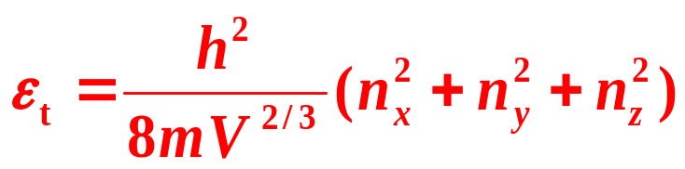
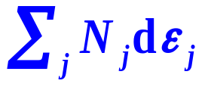

2
2
Fixed N_{i}, the change of ε_{i}
1
1
0
0
The spacing of the energy levels is relevant to V, represent the energy exchanged between the system and the surroundings through the work
-

Slide 20
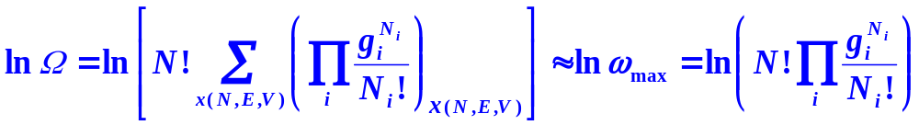

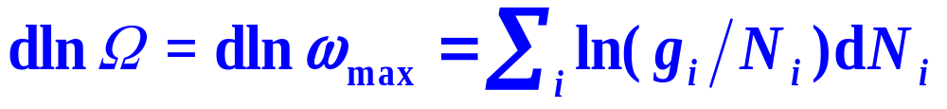
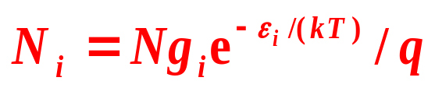
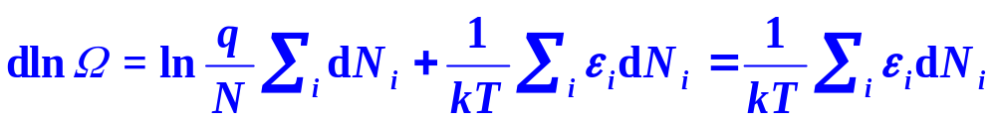
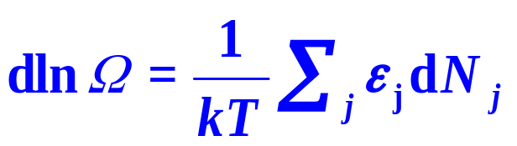

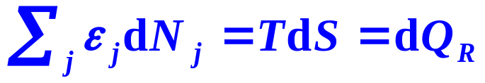
(2) Relation between Entropy and the Thermodynamic Probability
Comparison
-

Slide 21

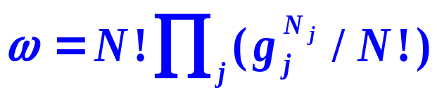


2. Derive the Maxwell-Boltzmann Distribution
(1) Find the Most Probable Distribution
Thermodynamic Probabilities of Distributions
Thermodynamic Probability of the Most Probable Distribution Is a Maximum

Slide 22


Boltzmann Relation
The physical meaning
It is a measure of the chaotic extent of the system. When Ω = 1, only one microscopic state, the system is the most regular, the chaotic extent is zero and S = 0. This is just the case of T=0, as shown by the third law of thermodynamics.

Slide 23



Boltzmann Relation
The more microscopic states possessed by a macroscopic state of the system, or the larger thermodynamic probability, the more chaotic is the system and the larger entropy will be.

Slide 24





(3) Relation between Entropy and the Molecular Partition Function
Independent-Localized-Particle Systems
Independent-Non-Localized-Particle Systems

Slide 25
Combining with the definitions
(U is replaced by E):
C_{V}=(∂E/∂T)_{V},
A=E−TS,
p=−(∂A/∂V)_{T},
μ=(∂A/∂n)_{T,V},
H=E+pV,
G=A+pV,

Slide 26










3. Relations to the Other Thermodynamic Functions
Localized
Non-Localized

Slide 27



Ideal-Gas Equation of State
as independent-non-localized-particle systems
General rule
Characteristic
Only the translational partition function is relevant to the volume V
Ideal-Gas Equation of State

Slide 28
Framework of the Chapter
III. Thermodynamic Properties of Independent -Particle Systems
12.7 Thermodynamic Functions of Independent-Particle Systems
12.8 Standard Molar Heat Capacity of Gases
12.9 Heat Capacity of Crystals
12.10 Standard Molar Entropy of Gases
12.11 Standard Equilibrium Constant of Gaseous Reactions

Slide 29










At normal temperature
Nk=nR
Diatomic Molecules

Slide 30






The molar heat capacity is then

Slide 31
Framework of the Chapter
III. Thermodynamic Properties of Independent -Particle Systems
12.7 Thermodynamic Functions of Independent-Particle Systems
12.8 Standard Molar Heat Capacity of Gases
12.9 Heat Capacity of Crystals
12.10 Standard Molar Entropy of Gases
12.11 Standard Equilibrium Constant of Gaseous Reactions

Slide 32








Expressions for Entropy
For the independent non-localized-particle systems,

Slide 33





Translational Entropy
Rotational Entropy
Linear
Nonlinear
Vibrational Entropy
Diatomic
Multi-atomic

Slide 34






Example Calculate of gaseous HCl at 298.15K using statistical
method.
Solution：

Slide 35
Features of Spectroscopic Entropy
The thermal entropies can be obtained theoretically by statistical mechanics; and the microscopic molecular characteristic properties are usually obtained by the spectroscopy, those entropies are correspondingly called the statistical entropy or the spectroscopic entropy.
The contributions from various motions are different.
S_{t} > S_{r} > S_{v}
The larger the molecular mass, or the larger moment of inertia and the smaller the symmetry number at the same mass, the larger standard molar entropy of a gas will be.

Slide 36
Exercises
Of the partition functions of translation, rotation and vibration, which one is related to the volume of the system?( )
At the same temperature, the total number of the microscopic states of gas is ( ) than that of the liquid.
At the same temperature, the partition functions of translation, rotation and vibration are in the sequence of ( )
When a gas expanse isothermally, the total number of the microscopic state will ( )
translational partition function
larger
translation > rotation > vibration
increase

Slide 37







Exercises
(1) According to the Boltzmann Relation , When the entropy of an isolated system increases , what is the increase of the microscopic states?
(2) For a monatomic ideal gas, what is the partition function?
Since
and
Verify:
and

Slide 38







Exercises
Solution: (1)
Solution: (2)
Solution: (3)

Slide 39
Framework of the Chapter
General principles of equilibrium at the transition level
from microscopic to macroscopic
I. Principles of Statistical Mechanics
II. Statistical Distributions of Independent Particle Systems
III. Thermodynamic Properties of Independent-Particle Systems
Description of Microscopic States
Thermodynamic Functions
Maxwell-Boltzmann Distribution
  Standard Heat Capacity of Gases
Fundamental Postulates of Statistical Mechanics
  Standard Entropy of Gases
The Most Probable Distribution
  Heat Capacity of Crystals
  Molecular Partition Function
  Standard
  Equilibrium Constant

